Slide 1
Big Mountain Ski Resort
A data science investigation

Slide 2
Problem Identification
Identify key features that would allow for increased revenue at the resort
What facilities or aspects of a ski resort contribute to increase ticket prices
What extra aspects should be cut to reduce overhead costs

Slide 3
Features to add: one run at base extending 150’ down from current base and associated chair lift
Features to remove: 6-8 least-used runs

Slide 4
Methods
Data cleaning and organization
Not all resorts reported on ticket prices - used median values from other resorts in that region to fill in
Unable to assume or estimate values for other variables
Two likely errors in data set
Silverton Mountain in CO - documented as 26819 ac - likely incorrect - substituted separate data point of 1819 ac
One resort reported having been open for 2019 years - more likely opened around 2019, but was removed from data set as this was unclear

Slide 5
Methods Cont’d
Used linear regression and random forest regression models to develop ML algorithm for identifying key features associated with increased ticket prices.
Tested both with 70/30 split of data
Identified best predictive model based on MAE and St Dev
Linear regression:
MAE: 11.79
St Dev: 1.62
Random Forest:
MAE: 9.50
St Dev: 1.35

Slide 6
Methods Cont’d
Applied random forest model to 100% of data (- Big Mountain)
Major predictors of ticket price: vertical drop, snow making (acres), total chairs, fast quad lifts, total number of runs, the length of the longest run (miles), total number of trams, and total skiable terrain (acres)
Final recommendations for added infrastructure:
Add one run at base of mountain and associated chair lift associated with $1.99 increase in ticket value
Close 6-8 least-used runs

Slide 7
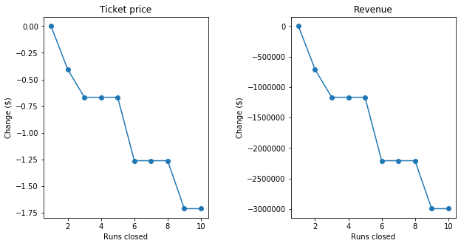
Closing 6-8 runs likely ideal number to close for greatest savings on OH costs vs loss of ticket value

Slide 8
$3474638
Adding additional run at base of mountain and associated chair lift predicted annual increased revenue

